Slide 1
2015 South Australian Landcare Conference The Changing Operating Environment of Landcare
Engaging community in sustainable farming and farmers in conservation.
How do we keep our Landcare Groups Relevant, Vibrant and United?
Ruth Sommerville
Principal Consultant and Owner - Rufous and Co
Executive Officer & Project Manager – Upper North Farming Systems Group
Vice Chair and Grants Officer – Yacka Moorundie Landcare Group

Slide 3
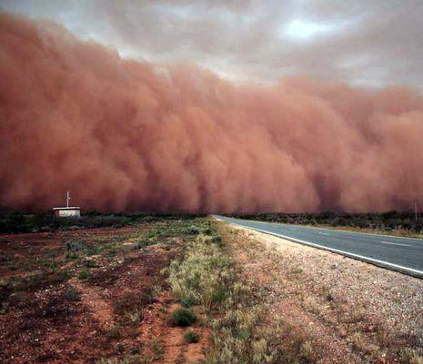
There had developed a significant divide once again in the community between the conservation movement and the farming community.

Slide 4
25 Years of Landcare
1989 - Landcare is a farmer focussed organisation born from a partnership between the biodiversity conservation sector and the agricultural production industry.
National Farmers Federation and Australian Conservation Foundation successfully lobbied the Australian Government, with bipartisan support, to commit to the Landcare Model.
What changes occurred in the first 20 years of Landcare?
Notes:
The “Decade of Landcare Plan” committed $320 million to fund the National Landcare Program 1900-2000.
2000-2010 – Landcare was funding driven. Landcare perceived to be a community engagement and conservation model
No longer a link between farmers and conservation
Landcare was perceived to have developed a greater focus on community engagement in conservation and the restoration of terrestrial and aquatic biodiversity. The development and adoption of improved cropping practices became a lower priority due to the private benefits gained from improved productivity. The development and adoption of improved grazing practices remained at the forefront of funding priorities due to a perceived public benefit from maintaining terrestrial flora and fauna species. The activities of the majority of Landcare groups and government organisations were driven more by the focus of the NHT, NLP and NAP funding programs than by local priorities. The historic focus of Landcare being driven by farmers to improve the whole of landscape function and sustainability was changing to focussing more on activities with perceived public benefit and moving away from those with production and profitability outcomes.
In 1997 there were more than 300 Landcare groups across the state of South Australia. These groups were undertaking a range of activities from the development of property management plans and the adoption of sustainable farming practices to revegetation, nature conservation, water quality monitoring and erosion control. Landcare was a whole of system, whole of landscape focussed community engagement tool.

Slide 5
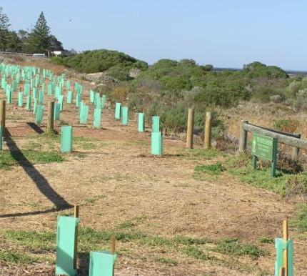
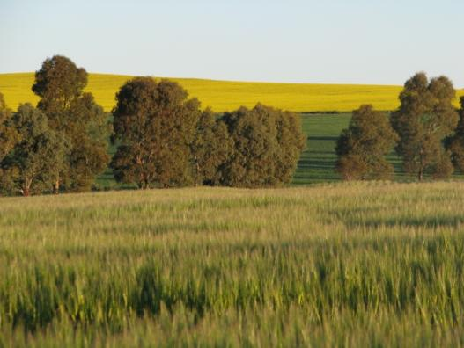
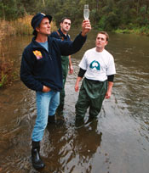
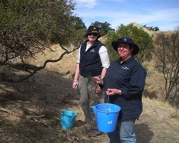
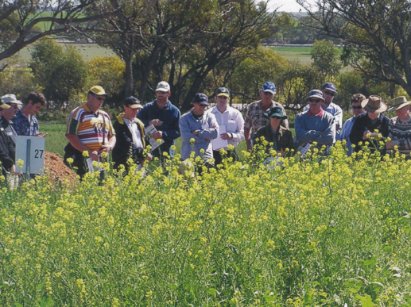
Notes:
Tree planting and farmer field day

Slide 6
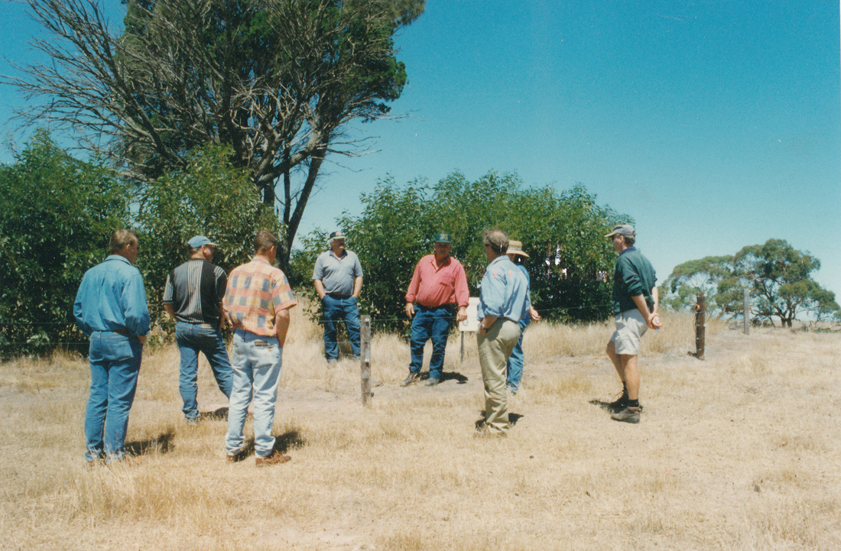
Notes:
Incorporated in 1998 to enable access to funding. Initial discussions on the development of a logo was for a $ sign. A group of farmers that wanted to improve the condition of their properties, reduce their erosion problem and increase the quality of the vegetation.

Slide 7
2015 – A New Operating Environment
Significantly reduced public funding
Public funding focussed on public benefit
Reduced levels of technical support from government agencies
How do we maintain the Landcare Model, all that it stands for and all that it can achieve into the future?

Slide 8
What does a Landcare Group Look like?
Notes:
If we are going to ask ourselves “How do we keep our Landcare Groups Relevant, Vibrant and United?” It is vitally important that we understand what a Landcare Group consists of and ask the question, of why it exists? What made this group of people come together? Why would someone want to be part of a group focussed on sustainable environmental management in our region, where ever that region may be?

Slide 9
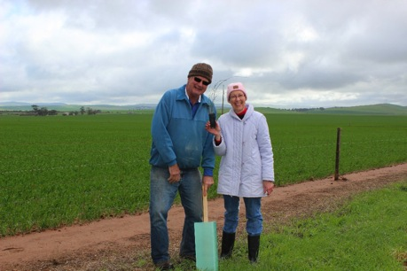
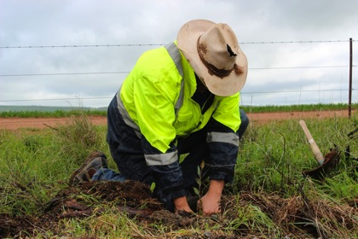
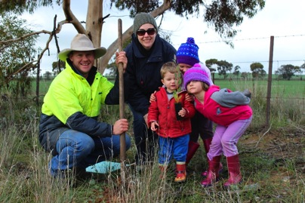

Slide 10
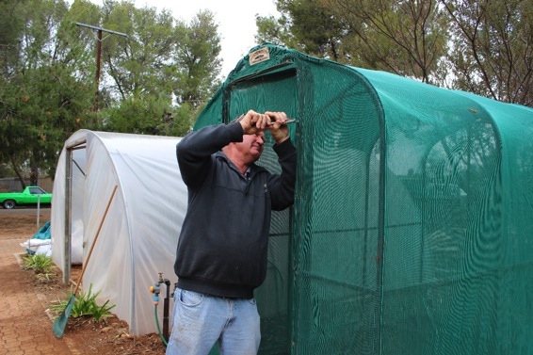
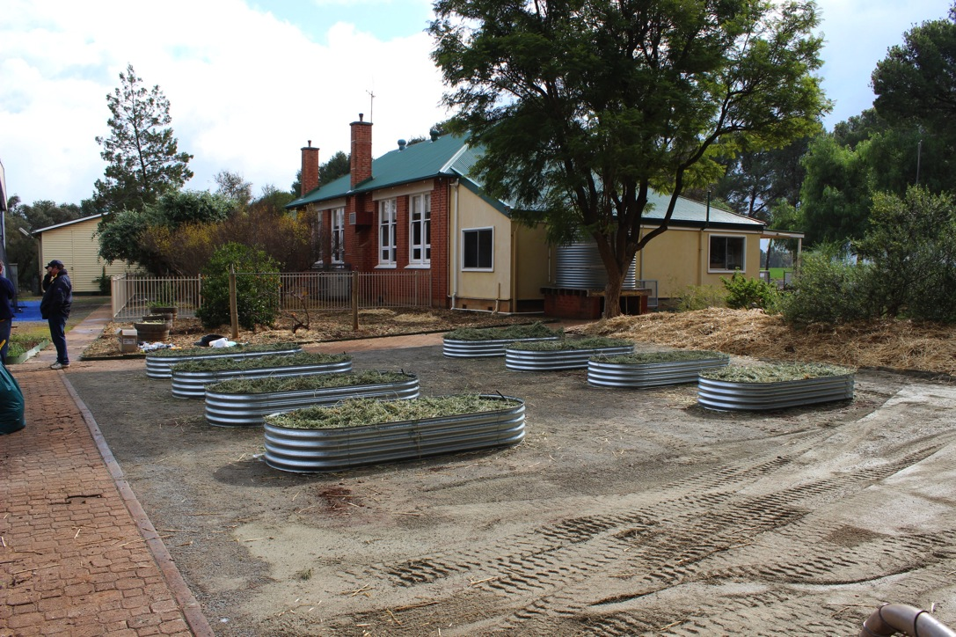
Spalding Primary School “Get into Nature” Project

Slide 11
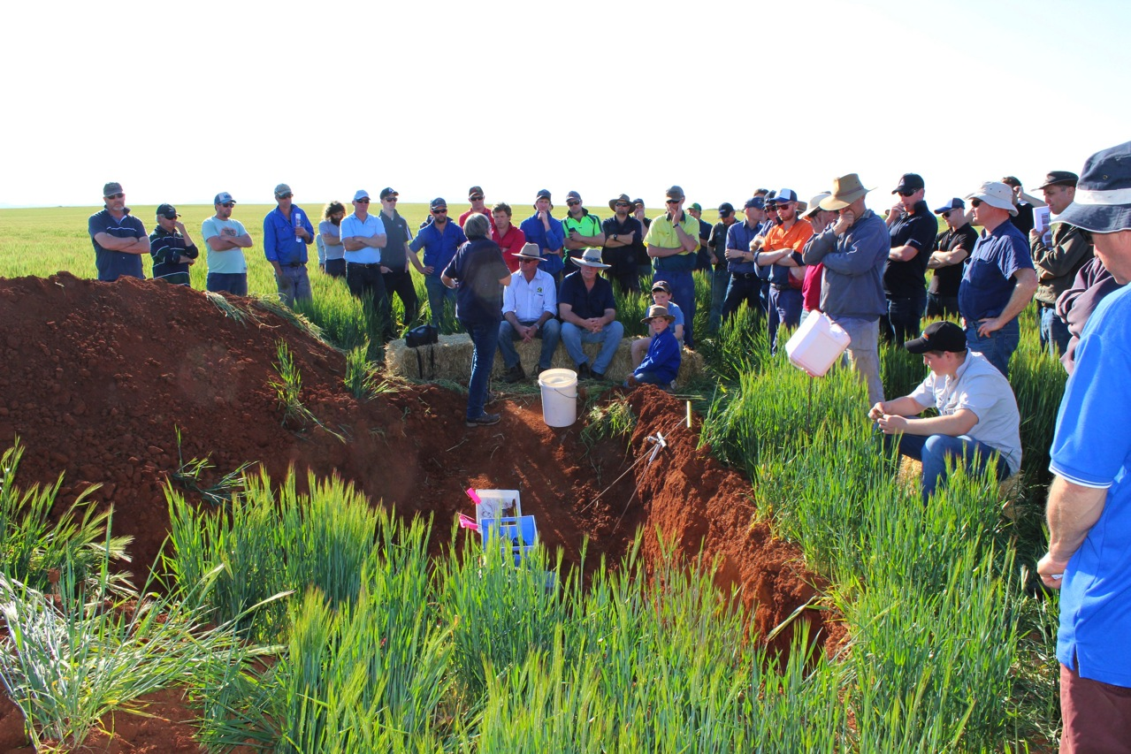

Slide 13
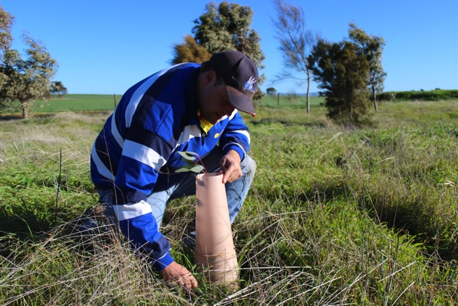
Landcare is about people
Sustainability Focus
Why do it together?
Why not just do it independently?
Notes:
My 2010 presentation didn’t have a single photo of a person…I looked at what they achieved, not who and why the projects were being driven by. That’s why I couldn’t answer the question. Landcare is about people driving change and supporting their communities to be more sustainable and ecologically aware.
People join groups for different reasons and it is important to understand these reasons, and seek to meet these needs.

Slide 14
What's in it for Me? Why should I join?
To network and interact with like minded people
To give back to the community
To gain support
To provide support
To belong and be valued
W.I.F.M.
Notes:
Support: Expertise, Financial, Moral

Slide 15
Meeting your members WIFM’s
Review
Relevant
Maintain the Social Side
Implementation not just Information
Create a Buzz

Slide 16
Two Groups Undertaking Change

Slide 18
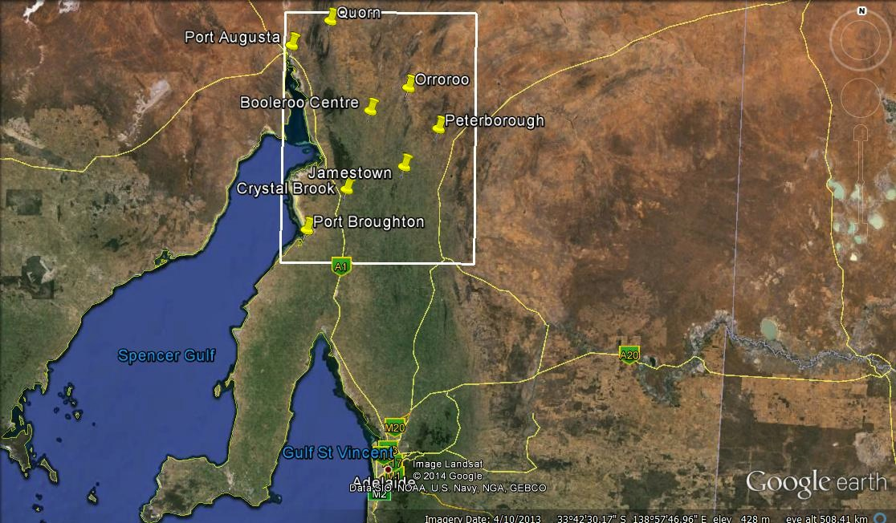

Slide 19
Why did UNFS instigate change?
From 2010 to 2013 the group lost 145 members
Change in management
The committee was adamant there was a need
They wanted to thrive, not just survive.
Notes:
2014/15 we have regrown to 140 members.
79 have not been members for more than 3 years or are new members.
Why have they returned or decided to join for the first time?

Slide 20
We Underwent Review
Why are you no longer a member?
No longer mixed farming focused
No longer a social group
No longer farming
Why did you become a member in the first place
What should the Strategic Direction be?

Slide 21
We responded!
We reviewed our content
We became independent
We revisited the regions, the “hubs” & social element.
We focussed on implementation not just information
We created a buzz around our activities

Slide 22
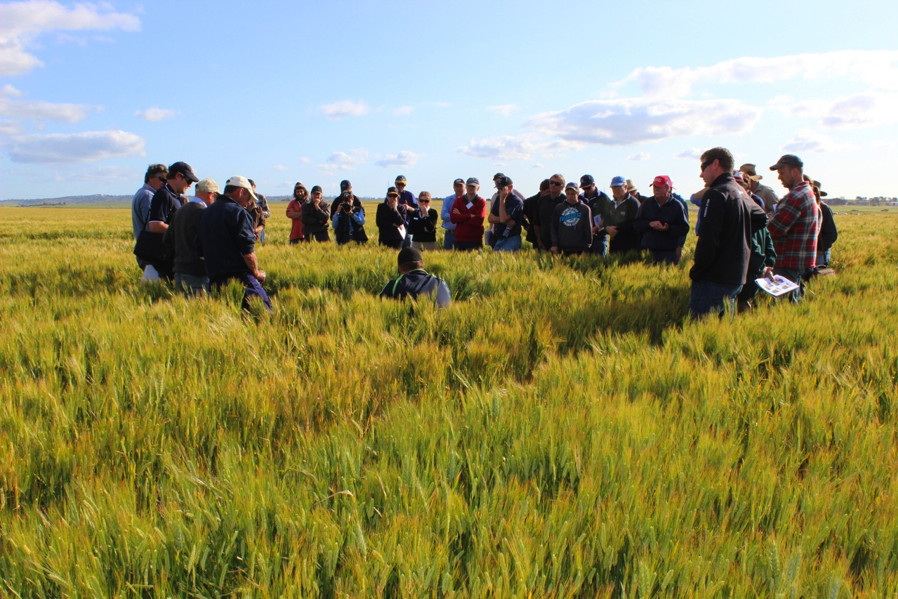
Independent and Farmer Driven

Slide 23
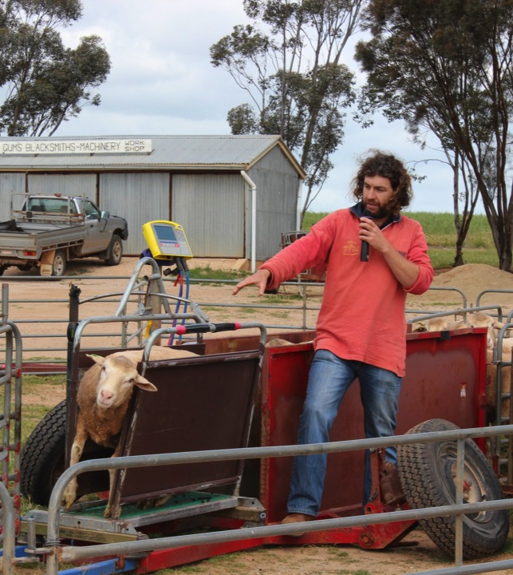
Include content without funding

Slide 24
Relevant and Timely

Slide 25
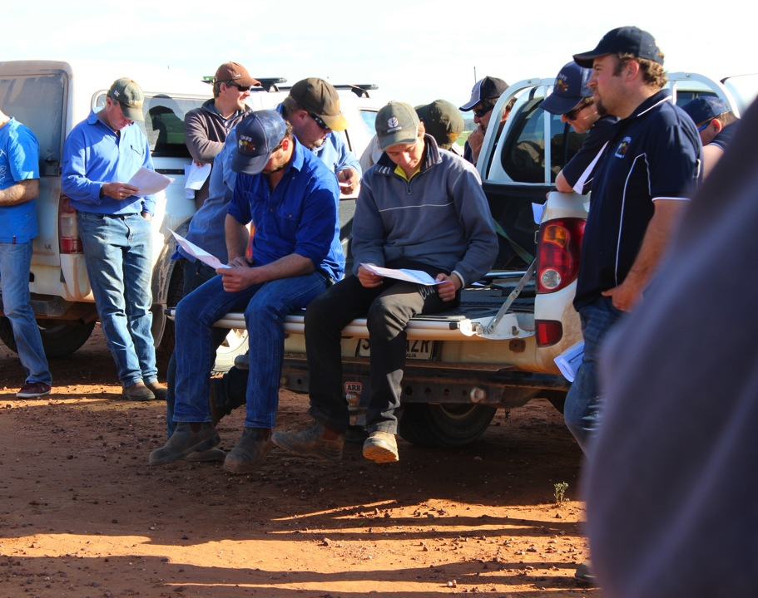
Born out of a Social Need

Slide 26
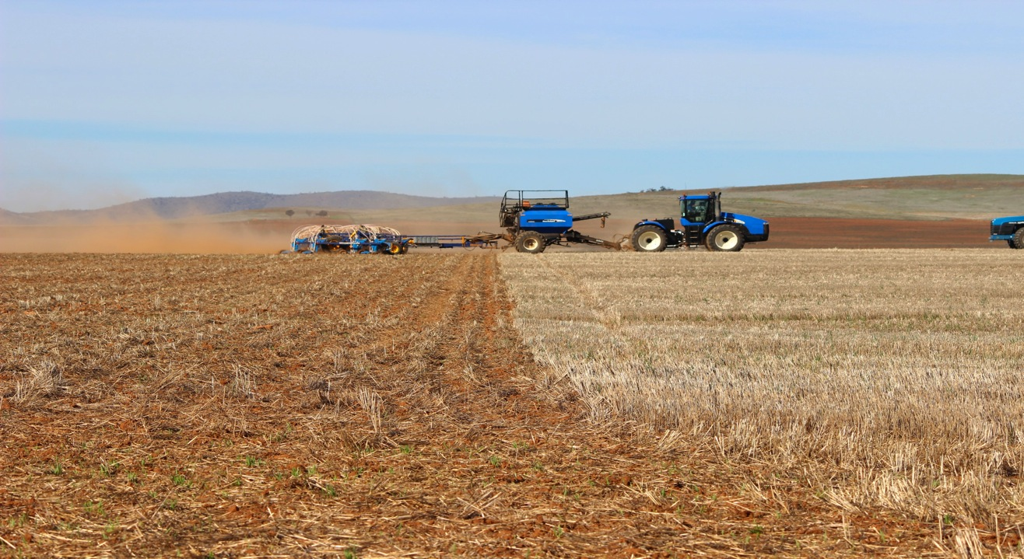
Focus on Implementation not just Information

Slide 27
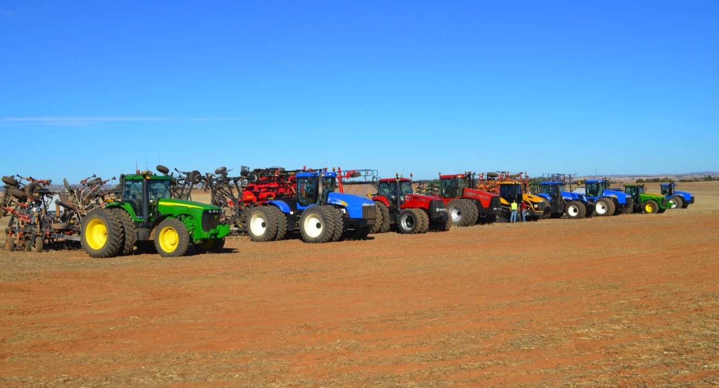
2013 Seeder Demonstration – The Buzz Effect
Notes:
Over 300 people visited this trial.

Slide 28
Background: Why do a Seeder Demonstration?
Adoption of no till farming systems is significantly lower in the Upper North
Many farmers still cultivating paddocks before sowing.
It tackled sustainability, profitability and productivity.
It involved big machines and a good old competition!

Slide 29
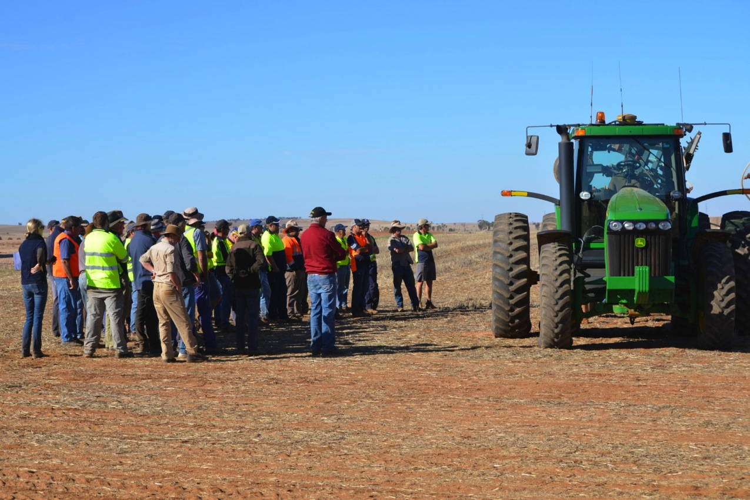

Slide 30
We are thriving
Increase, Improve and Target Communication
Relevant Projects and Activities
Create Competition/Sport/Social Components
Focus on Implementation, not just Information
Find something that creates a Buzz

Slide 33
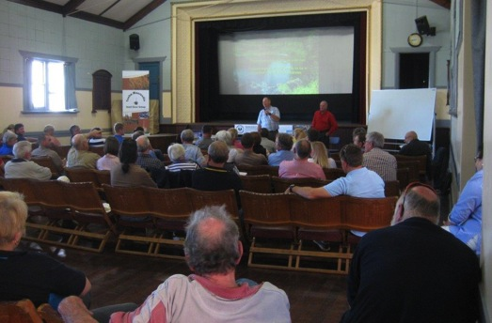
Why did YMLG instigate change?
3 years of inactivity
Next generation
Dwindling attendance at meetings
Great attendance a feature events
Still a need in the region!

Slide 34
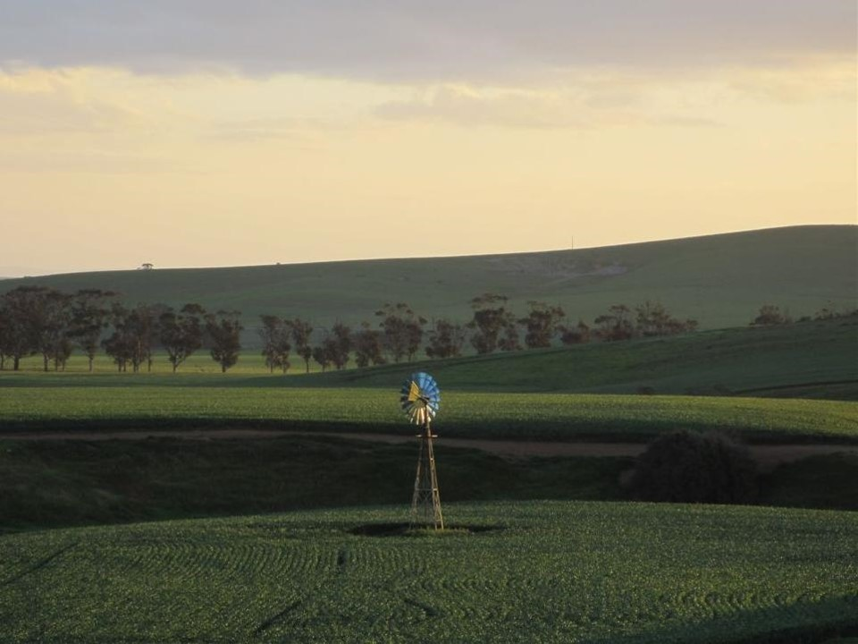
Reviewed our position
We discussed the reasons for a 3 year period of inactivity
We reviewed our meetings
We talked to the community
Formed an Executive Team
Notes:
Moved away from a single person leadership model
Where did we lose the interest of our members

Slide 35
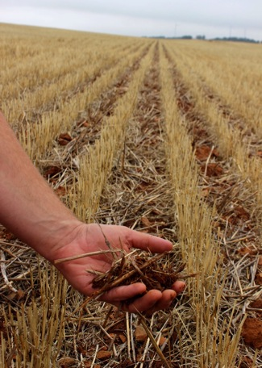
Relevant and Interesting How to, Where do I find, How does it impact me?
Native Vegetation Legislation
Stone walls
Dung beetles
Raptors
Soil Carbon
Water in the landscape

Slide 36
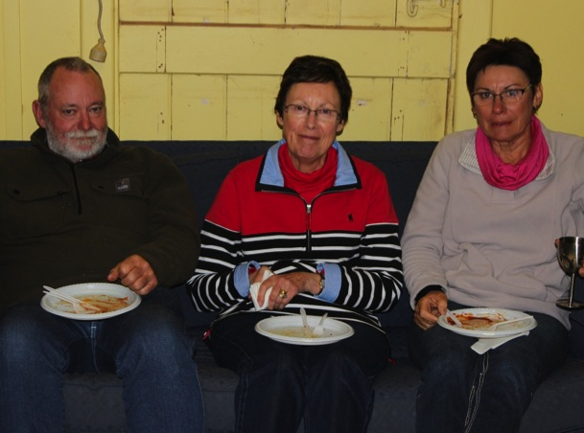
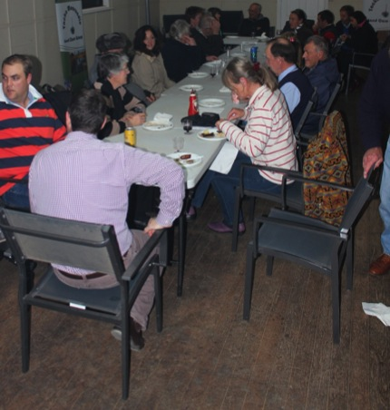
Sausage, Salad and a Glass of Red
Notes:
Information nights rather than formal meetings - Our members wanted to know what others were doing, not just focus on what the problems in our area that we didn’t have the funds to fix were. Outward focus.
Our Members wanted to get back to a social setting. Not a meeting room.

Slide 37
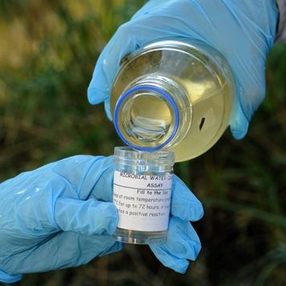
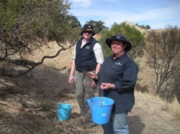
Implementation not just Information
Support to put in grant applications.
Reinstated water monitoring
Trees for life propagation
List of where to source information and resources
Seed Collection for the State Seed Bank

Slide 38
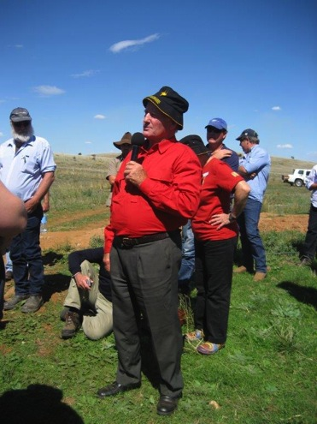
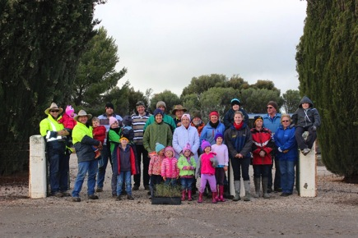
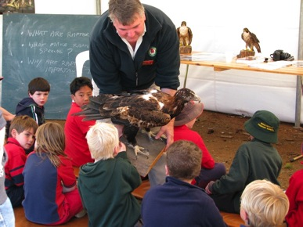
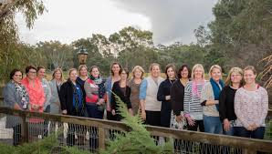
Create a Buzz; Reach out to more than just the stalwarts…
Environmental Education Days
Peter Andrews Day
Trees for Mum and Dad Tree planting
Towards Sustainability Workshop

Slide 39
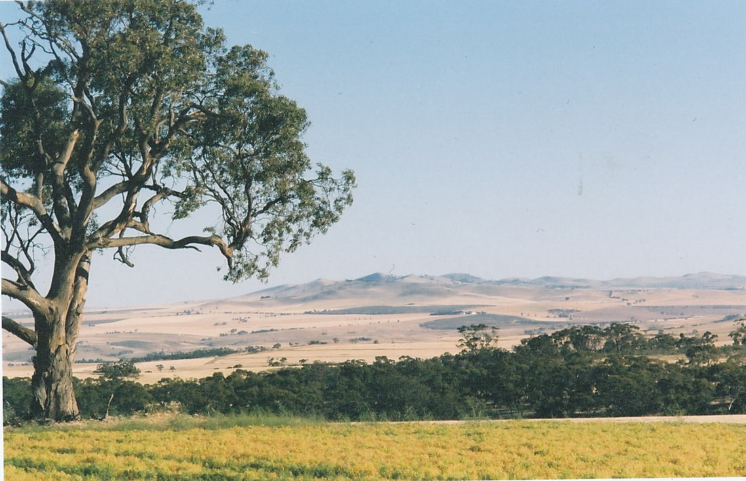
Where are we now?
More attending each event and new members joining
All ages coming
School undertaking Landcare projects
Landholders supporting & encouraging their neighbours in the “Landcare Spirit”
Still more to come.

Slide 40
Two Groups One method Once struggling, now thriving

Slide 41
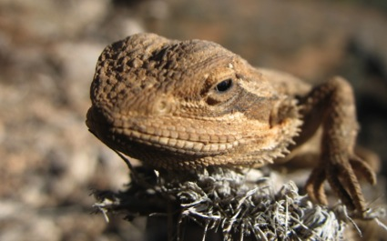
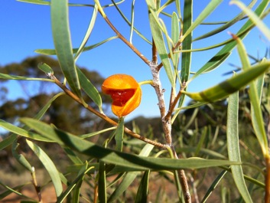
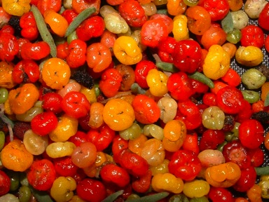
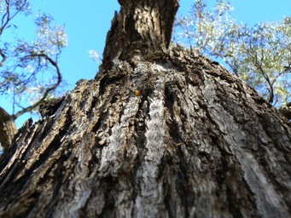
Landcare Groups: Relevant, Vibrant & United Take Home Messages
Review
Relevant
Maintain the Social Side
Implementation not just Information
Create a Buzz

Slide 42
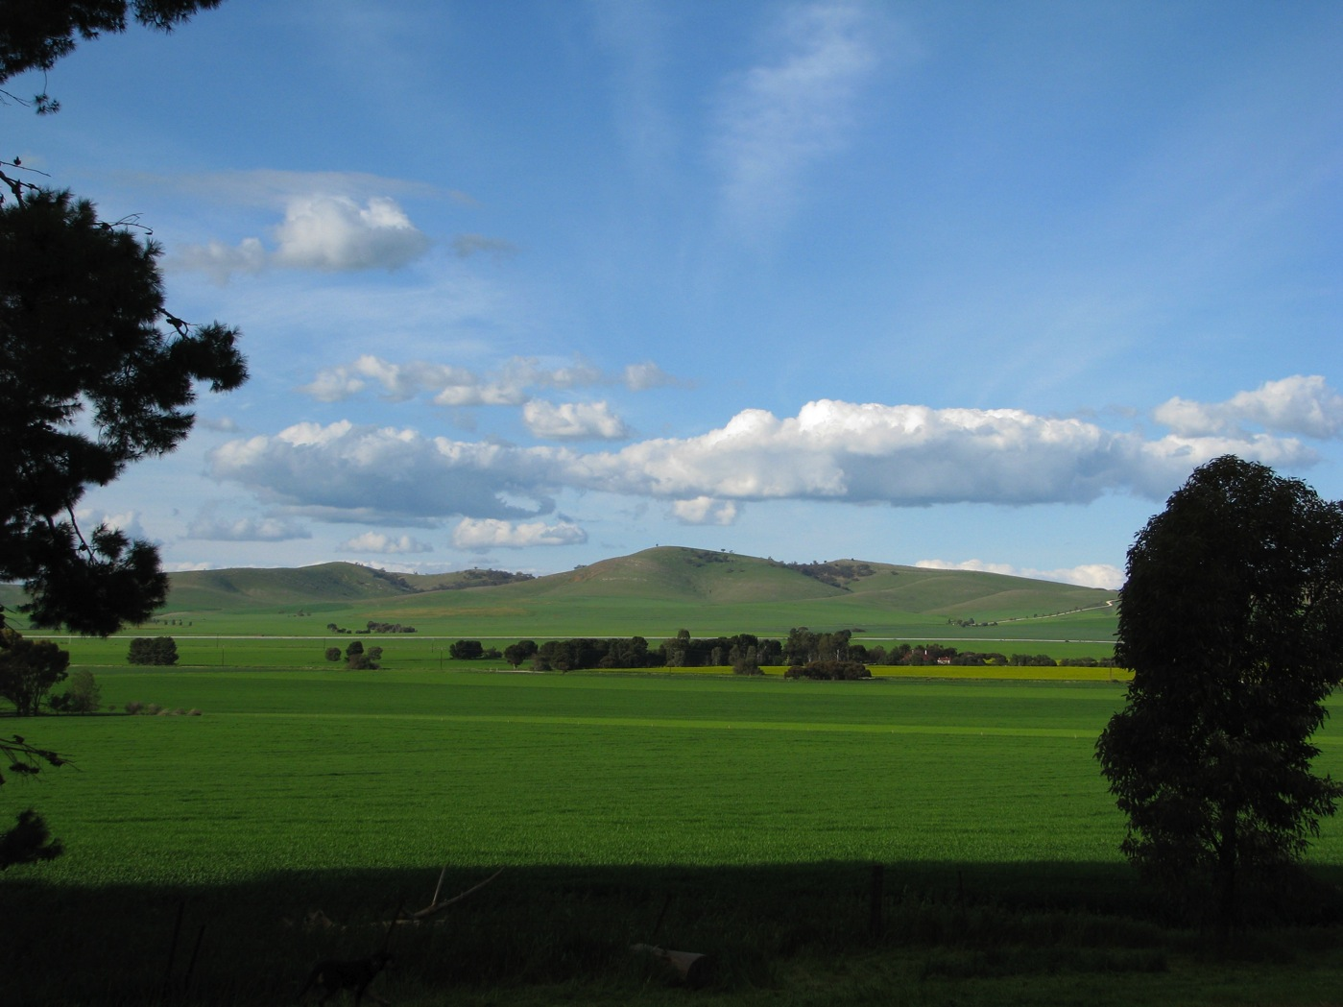
Thankyou
Ruth Sommerville
Principal Consultant and Owner - Rufous and Co
Executive Officer & Project Manager – Upper North Farming Systems Group
Vice Chair and Grants Officer – Yacka Moorundie Landcare Group
rufousandco@yahoo.com.au
0401 042 223

